Slide 1
How successful companies last longer
Lessons in Longevity from an 88-Year-Old Zipper Company

Slide 2
Today’s companies scenario
In an era of fast-changing global markets, hyper-connectivity, heightened competition, and increased customer expectations, it’s difficult to stay on top for long. Leading brands, such as Nokia, more Blockbuster, Kodak, Borders, Sports Authority, and Toys R Us, have all fallen by the wayside, even as others are relegated to being small players.
In the U.S. alone, roughly 65% of companies fail during
the first 10 years. In fact, only about 25% of businesses
survive to make it to 15 or more years, according to the
U.S. Bureau of Labor.
Organizational longevity relates to how well a firm
succeeds across different markets over time, irrespective
of its original objectives and founders

Slide 3
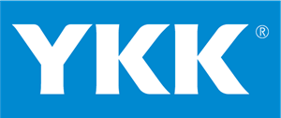
Introduction to Insights to Longevity
YKK, founded in 1934, manufactures and produces approximately 10 billion zippers a year. The YKK Group consists of two main operations – the fastening business and the architectural products business.
The fastening business, which includes the zippers its makes for the apparel industry, comprises approximately 40% of its global business. And The architectural products business, which includes products for windows, doors, curtain walls, and even bridges and ocean clean-up products for the oil and gas industry, comprises the other 60%.

Slide 4
Case study of
We will examine a case study of YKK, a successful 88-year-old company.
We have studied YKK’s American operations for the past three years. Our initial visit to YKK National Manufacturing Center in Macon, Georgia, took place in 2019. During the visit, we had a look behind the scenes, and conducted informal interviews with several executives and employees, including YKK’s vice president of community engagement and corporate communications.
YKK currently has operations in 73 countries through 100 wholly owned subsidiaries. Since its inception, it has endeavored to create “better products at lower costs and greater speed, ”
YKK sources its own raw materials and produces patented manufacturing equipment. Most importantly, it enables the company to respond quickly to customer needs and also quality of its products high while also ensuring lower cost.
Let’s examine what factors contribute to YKK’s ongoing success in the next slide.

Slide 5

Lessons from YKK 1. Commitment to stakeholders
In many ways, YKK was ahead of its time when its founder and chairman, Tadao Yoshida. It also includes respect, dignity, and honor.
As a result, YKK goes to great lengths to connect with stakeholders on a local, community and on a global level.
A key part of stakeholder engagement is giving back to the community and operating in a sustainable fashion.
It started providing a yearly financial, social, and environmental report in 2017. In 2021 the company reported that it invested 2.5 billion Yen (U.S. $23 million) on sustainability related investments.
YKK’s recycling rate is exemplary. At 82.3%, it’s well above the average in comparable industries (textile 14.7% in 2018, and clothing footwear 13%).

Slide 6

Lessons from YKK 2. Private ownership
Many privately owned companies at some point decide to either list publicly or sell out to large private equity firms. YKK did neither, which gives it plenty flexibility to decide its strategic direction without the constant pressure of quarterly returns.
YKK’s financial statements reveal slow but steady growth through the years.
As we can clearly see from figure, These statements indicate that zippers provide the steady, if not spectacular, profits for the YKK group, while the architectural group allows the company greater scale, access to innovation and income
YKK offers all of its employees an opportunity to participate in the ownership of the company as stockholders and even receive dividends. At present, the employees’ stock ownership association is the head of YKK Corporation’s shareholders.

Slide 7


Lessons from YKK 3. Focus on quality
One of YKK’s core values is “insist on quality in everything, ” and, according to the company’s own website, all of its business activities revolve around the assurance of quality. Each YKK production site conducts various quality tests and regularly reports these to the headquarters in Japan.
This approach also ensures that YKK can respond quickly to customer needs and special requests. Lastly, it leads to advantages in terms of quick, coordinated deployment of new methods and technologies
4. Company Values
YKK’s corporate governance system is further operationalized through its core values:
Do not fear failure; experience builds success/creates opportunities for employees.
Insist of quality in everything.
Build trust, transparency, and respect

Slide 8

Lessons from YKK 5. Local embeddedness
Firms can overcome the so-called “liability of foreignness, ” and are viewed as an indigenous social and economic actor. Throughout its history, YKK has made a deliberate effort to establish strong local roots, and this has led to acceptance even in the most closed of markets.
YKK’s focus on local even manifests itself in different operations within one country. In the U.S., for instance, where YKK has six manufacturing facilities, the firm successfully integrated the firm’s traditional Japanese values.
Employees adopted YKK’s traditional cycle of goodness while maintaining values such as a relaxed pace of life, a sense of informality, and southern hospitality.

Slide 9

Lessons from YKK 6. Dynamic adjustment to industry changes
When examining factors that influence a firms’ longevity, one must consider the competitive landscape, rate of innovation, and technological change.
The global zipper industry seems relatively static, but it’s interesting for several reasons:
Zippers are a specialty item that is not marketed directly to consumers.
while the zipper industry is relatively obscure, it is also large, with annual sales in between $7 and 13 billion (U.S.), with a CAGR between 5.4% and 7.6%.
The global zipper market is also highly fragmented, with many local and regional players, and competition along the traditional lines of cost, quality, and innovation.

Slide 10

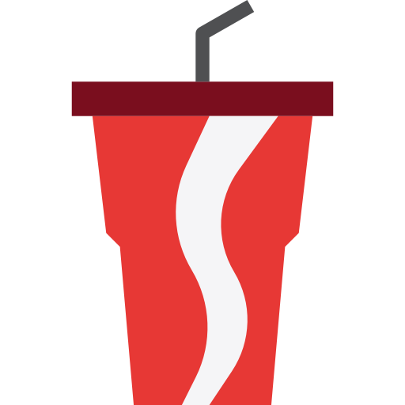
Key Lessons for other firms
Looking across industries, there is no question that these six factors apply to other, long-time successful multinational companies. For example, Coca-Cola’s standardized quality, local bottlers, company culture, barriers to entry and commitment to its stakeholders have served it well during its many years atop the global soft drinks industry
Here are five key take-aways from YKK’s example as they contemplate how to stay on top:
Private ownership certainly contributed to stability and employee loyalty, but results for at least half its business (architectural products) have been underwhelming for a long time.
YKK could make the case that there is some cross-subsidization going on, as the areas outside the core business were not as profitable.
YKK is well known to companies in the garment sector, but it is relatively unknown among consumers.
Continue to serve it well as industries become more automated and lower-cost competitors compete with quality products
Focus on sustainability issues.

Slide 11
References:
YKK company. (n.d.). The YKK group. https://www.ykk.com/english/corporate/group/
U.S. Bureau of labor statistics. (n.d.). https://www.bls.gov/bdm/us_age_naics_00_table7.txt
Flaticon. (n.d.). Vector Icons and Stickers. https://www.flaticon.com/
Harvard Business Review. (n.d.). https://hbr.org/2022/03/lessons-in-longevity-from-an-88-year-old-zipper-company

